Slide 1

Percentage
Math 1435 Math Fundamentals

Slide 2
Percentage definition
Percent means “per hundred”. Percent is a type of fraction where the denominator is always 100. 20/100 = 20%
When written, we use the % sign instead of writing it as a fraction.
Percentages can also be written as a decimal.
Common uses for percentage in cabinet making are:
Waste factors of wood (solid & panel)
Waste factors of finishing materials
Calculation of consumables (% of total estimate to account for things like glue, pin nails, screws, sand paper etc).
Overhead calculations for pricing/ estimating
Calculating taxes for paychecks & invoices

Slide 3
Percentage to decimal
Changing a percentage to a decimal
To change a percentage to a decimal simply divide the percentage by 100.
Since 12% is equal to 12/100 we divide the numerator and denominator by 100 to find the decimal equivalent. Write the formula as follows:
12 ÷ 100 = 0.12 (move the decimal over 2 places)
14% = 0.14
65% = 0.65
99% = 0.99
312% =3.12

Slide 4
Percentage – decimal to percent
Changing a decimal to a percentage
To change a decimal to a percentage, multiply the decimal by 100.
0.13 x 100 = 13%
0.55 x 100 = 55%
3.22 x 100 = 322%
Some notes:
if the number ends at the decimal (no numbers to the right of the decimal) then drop the decimal.
When changing from a percent to decimal. Place a zero in the ones column if there are no whole numbers.

Slide 5
Percentage examples
Percentage examples
Your earn $1500.00 per month. Your boss has given you a 5% pay increase. What will your new monthly pay be?
$1500.00 x 0.05 = 75.00 therefore your pay will increase by $75.00. your new pay will be $1575.00 (1500 + 75)
You are required to order 477 bm of s&btr 4/4 walnut for a job. The shop averages 60% waste on solid lumber. How much walnut should you order?
477bm x 0.6 = 286.2bm - Therefore, you need to order (477bm + 286.2bm) = 763.2bm of 4/4 walnut.

Slide 6
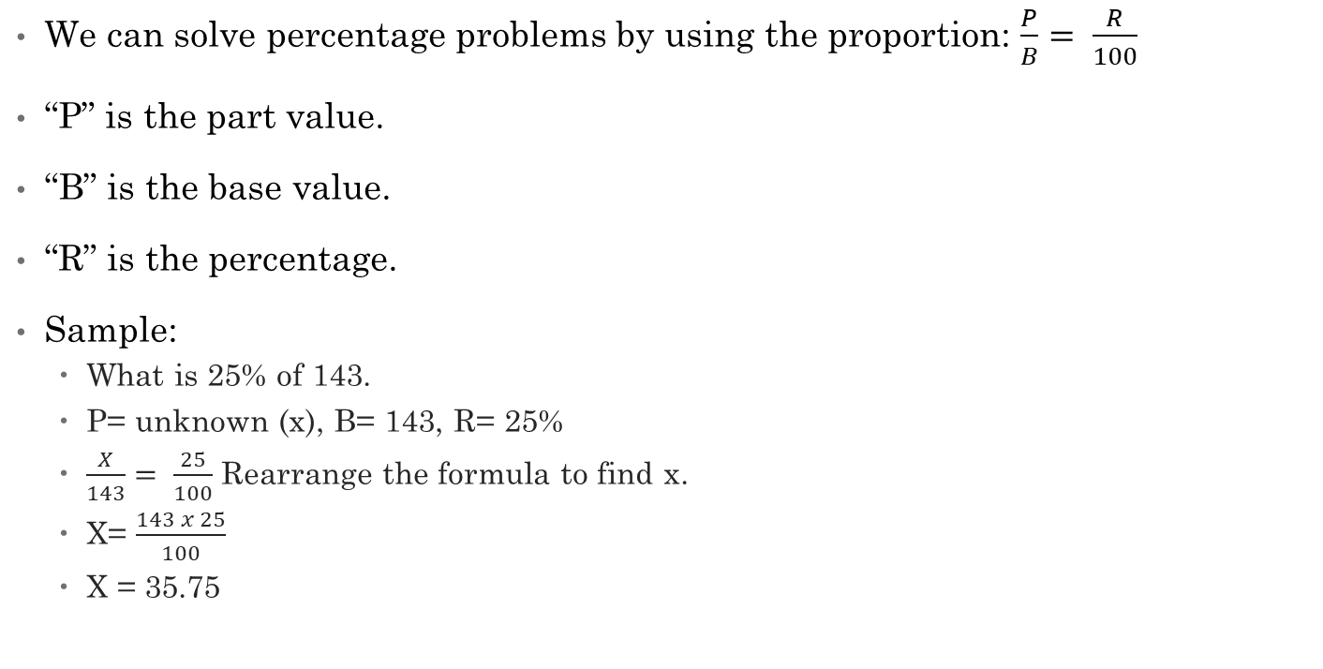
Solving percentage problems
We can solve percentage problems by using the proportion: $\frac{P}{B}= \frac{R}{100}$
“P” is the part value.
“B” is the base value.
“R” is the percentage.
Sample:
What is 25% of 143.
P= unknown (x), B= 143, R= 25%
$\frac{X}{143}= \frac{25}{100}$ Rearrange the formula to find x.
X= $\frac{143 x 25}{100}$
X = 35.75

Slide 7
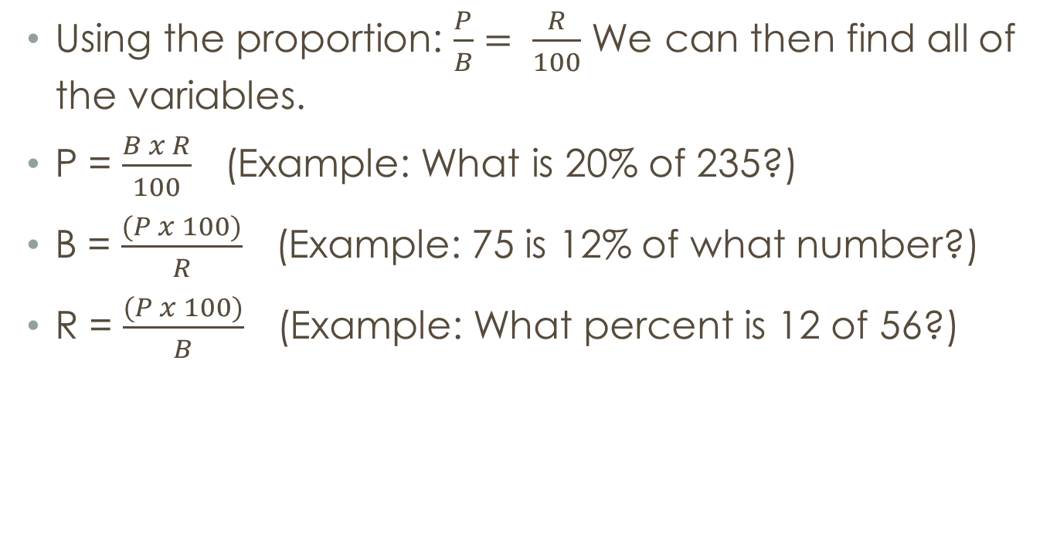
Percentage formulas
Using the proportion: $\frac{P}{B}= \frac{R}{100}$ We can then find all of the variables.
P = $\frac{B x R}{100}$ (Example: What is 20% of 235?)
B = $\frac{(P x 100)}{R}$ (Example: 75 is 12% of what number?)
R = $\frac{(P x 100)}{B}$ (Example: What percent is 12 of 56?)

